Slide 1
Stroke Prediction Analysis using SQL
Project Overview This project focuses on analyzing a real-world dataset related to stroke prediction using SQL. The goal is to explore patterns, trends, and relationships within the data that could help in understanding the factors influencing stroke occurrences.
Main SQL Objectives:
Clean and format the dataset
Remove duplicates and nulls
Create meaningful columns
Generate aggregated insights for Power BI
BY
Mohamed Ramadan

Slide 2
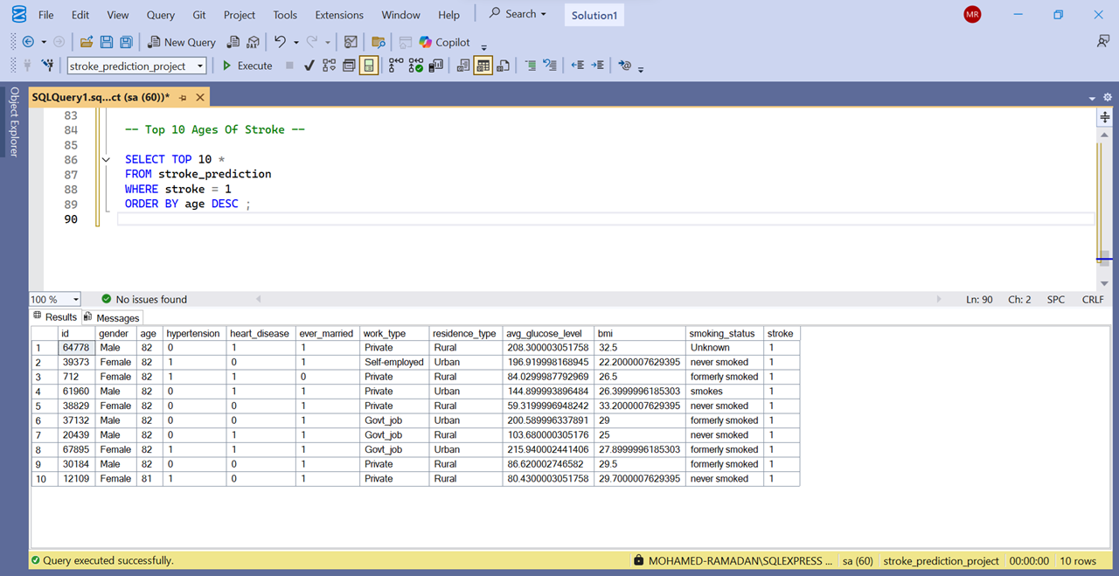
Top 10 Ages Of Stroke

Slide 3
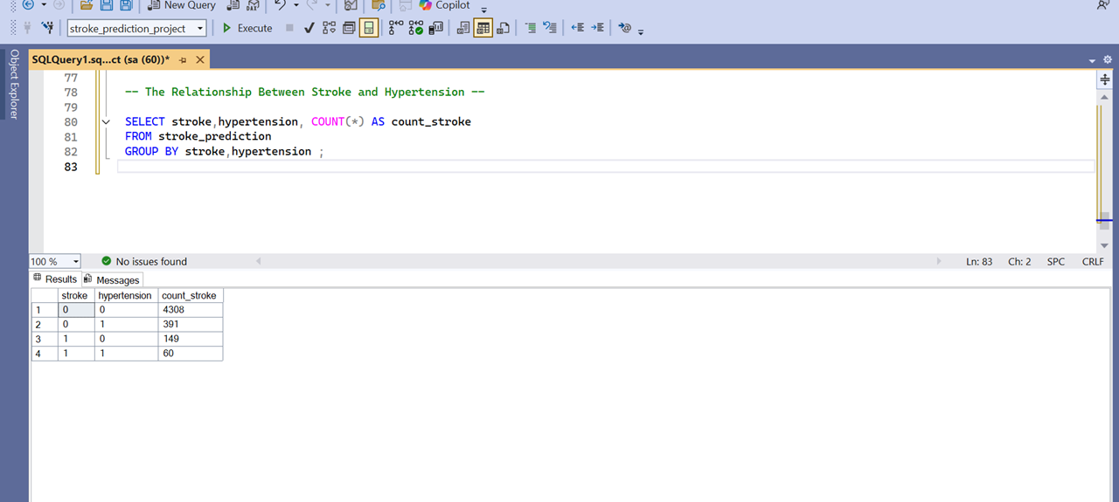
The Relationship Between Stroke and Hypertension

Slide 4
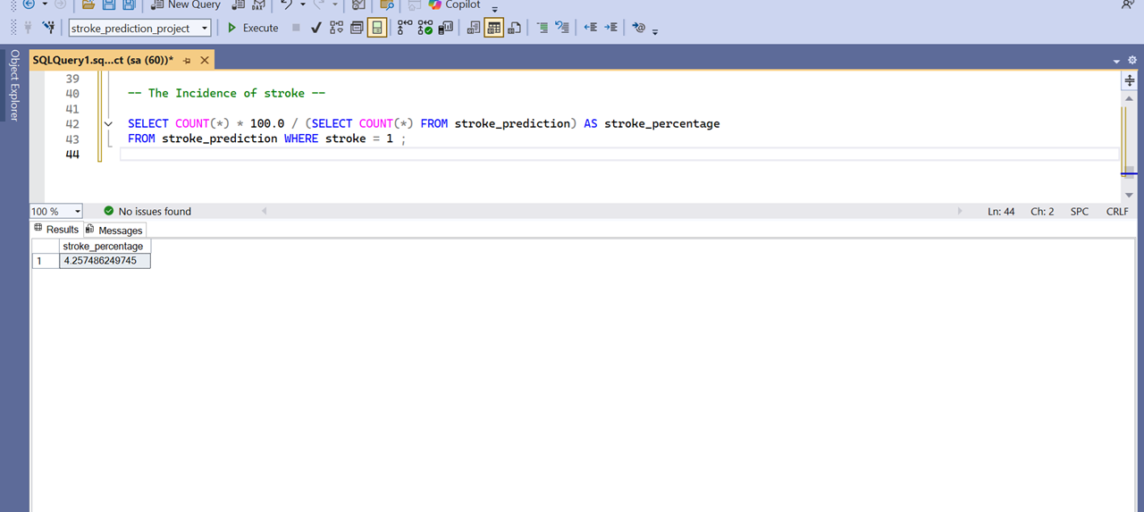
The Incidence of stroke

Slide 5
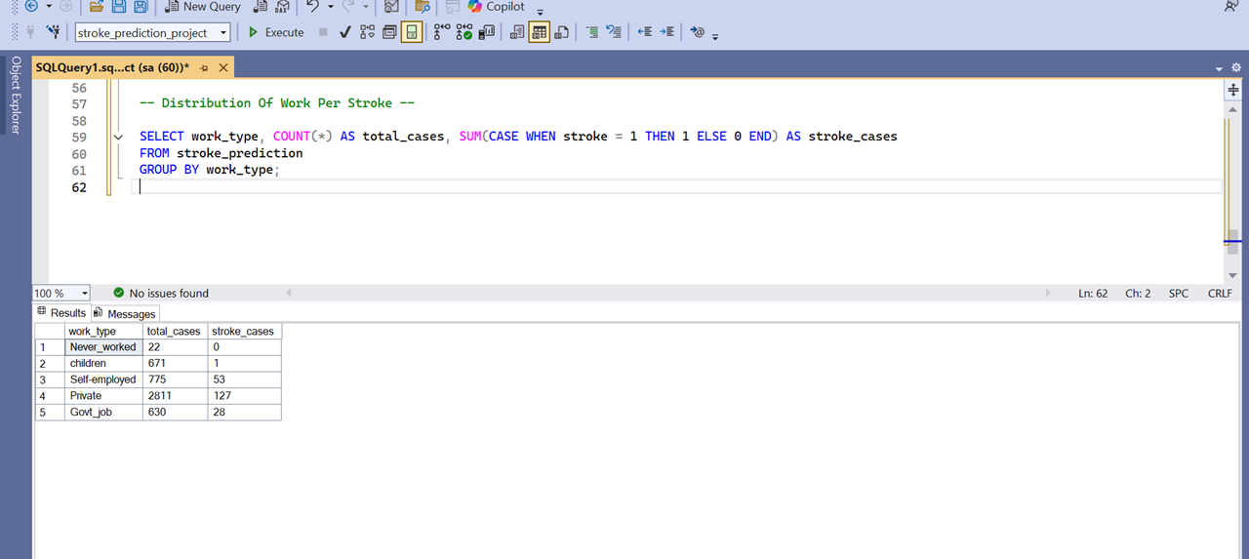
Distribution Of Work Per Stroke

Slide 6
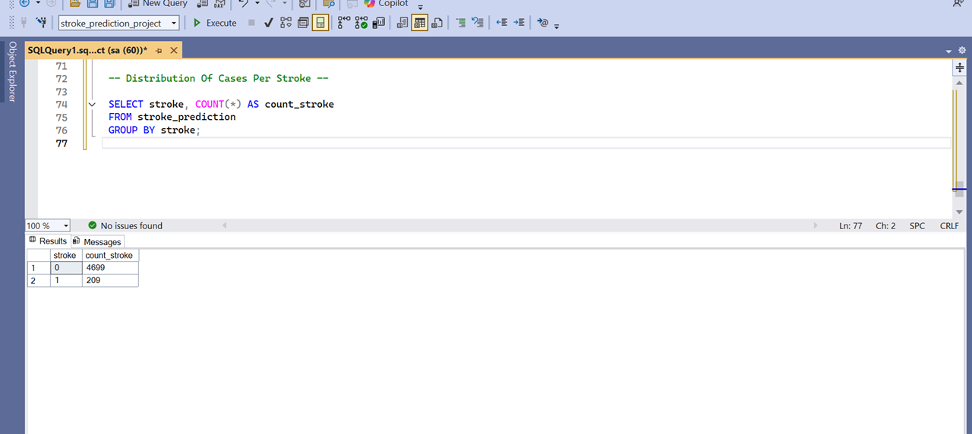
Distribution Of Cases Per Stroke

Slide 7
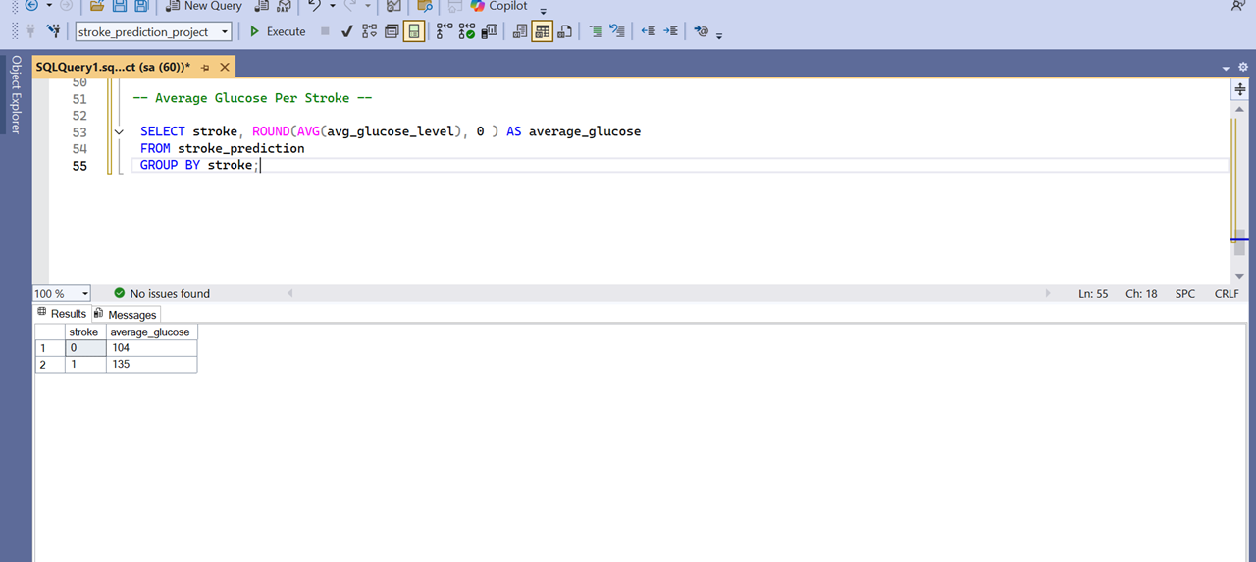
Average Glucose Per Stroke

Slide 8
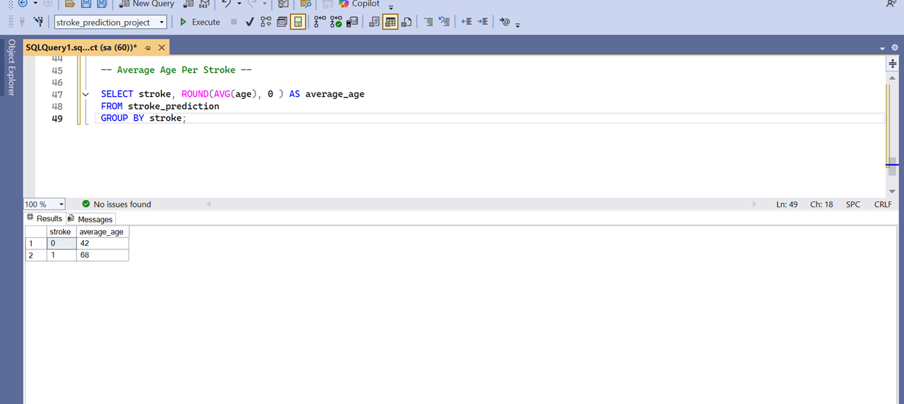
Average Age Per Stroke

Slide 9
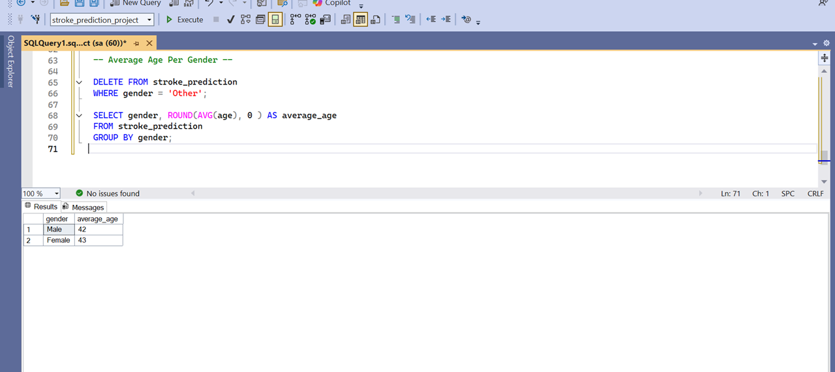
Average Age Per Gender

Slide 10
Summary of SQL Work
This project focuses on using SQL for cleaning, transforming, and analyzing a healthcare dataset related to stroke prediction.
The aim is to prepare the data for visual reporting and extract useful insights that help understand stroke risk factors.
By Mohamed Ramadan
mohamedredrees@gmail.com
+201118571691

